Slide 1

NeuroDOT
Tutorial:
Generating a Light Model
With a Split Pad

Slide 2
NeuroDOT Set-Up - Checklist
Before starting any tutorial, please make sure you’ve done the following
Download the appropriate versions of matlab, neuroDOT, and NIRFAST
Matlab: 2020b
NeuroDOT toolbox from NITRC
https://www.nitrc.org/projects/neurodot/
NIRFASTer-master
https://github.com/nirfaster/NIRFASTer
Set your path so that all required folders and subfolders are included
Folders w/subfolders to include
NeuroDOT toolbox
NIRFASTer-master
Your personal directory
Folders to include
Output directory

Slide 3
NeuroDOT Set-Up – Output Directory
Example output directory
Once you’ve set your path, the next thing you should do is set your output directory.
The output directory must be located within your path
If it isn’t already in your path, you must add it to your path
You can set your own path to an output directory in the line shown above
An output directory specifies the location where files will be saved
MATLAB, by default, will save files to the current directory
The following line of code will change your current directory to the output directory that you just specified →
Now you can save outputs directly to your output directory

Slide 4

Diffuse Optical Tomography
In diffuse optical tomography (DOT), arrays of optical sources and detectors are used to perform functional neuroimaging experiments on task-based or resting state modes of human brain function.
Analyses are broken into several pipelines:
B: modeling of the tissue shape, optical property distribution, and source/detector locations
C: modeling of the light emission, diffusion, and detection through the head
D: preprocessing of the raw source-detector measurements
E: reconstruction and spectroscopy of the preprocessed data and light model into a functional neuroimaging volume
F: post-processing analysis of these results.

Slide 5
Light Modeling Tutorials in NeuroDOT
NeuroDOT has several different tutorials that detail how to Generate a Light Model, each with its own purpose. They’re listed below to help you figure out which version is the best for your purposes.
Basic Light Modeling Tutorial with AlignMe
PPT: NeuroDOT_Tutorial_Generating_a_Light_Model_Pad_24x28_With_AlignMe
Script: Basic_Light_Modeling_with_AlignMe_Tutorial
Pad file: Pad_AdultV24x28.mat
Sparse Pad Tutorial with AlignMe
PPT: NeuroDOT_Tutorial_Generating_a_Light_Model_SparsePad_32x32_With_AlignMe
Script: Basic_Light_Modeling_with_sparse_Pad_and_AlignMe_Tutorial
Pad file: Pad_FullHead_32x32.mat
Light Modeling with a Subset of Measurements
PPT: NeuroDOT_Tutorial_Generating_a_Light_Model_With_Subset_of_Measurements_Pad_24x28_and_AlignMe
Script: Light_Modeling_with_Subset_of_Measurements_and_AlignMe_Tutorial
Pad file: Pad_AdultV24x28.mat
Split Pad Tutorial
PPT: NeuroDOT_Tutorial_Split_Pad_Light_Modeling_With_LUMO_Adult_Temporal_Pad_and_AlignMe
Script: Split_Pad_Light_Modeling_with_LUMO_Adult_Temporal_Pad_and_AlignMe_Tutorial
Pad file: LUMO_adult_temporal_pad.mat
Basic Light Modeling with Hummingbird
PPT: NeuroDOT_Tutorial_Generating_a_Light_Model_Pad_24x28_With_Hummingbird
Script: Basic_Light_Modeling_with_Hummingbird_Tutorial
Pad file: Pad_AdultV24x28.mat
Sparse Pad Tutorial with Hummingbird
PPT: NeuroDOT_Tutorial_Generating_a_Light_Model_SparsePad_32x32_With_Hummingbird
Script: Basic_Light_Modeling_with_sparse_Pad_and_Hummingbird_Tutorial
Pad file: Pad_FullHead_32x32.mat
Light Modeling with Adult 96x92 Pad
PPT: NeuroDOT_Tutorial_Generating_a_Light_Model_Pad_Adult_96x92_Example
Script: Basic_Light_Modeling_with_AlignMe_Tutorial_Pad_Adult_96x92
Pad file: Pad_Adult_96x92.mat
Note: this tutorial’s PowerPoint is in an older style

Slide 6
Generating a Light Model – Split Pad Tutorial
This tutorial will follow the Split_Pad_Light_Modeling_with_LUMO_Adult_Temporal_Pad_and_AlignMe_Tutorial.m Matlab file which can be found in the Documentation/Scripts folder.
The tutorial will:
Generate a mesh from a segmented volume
Place an array of sources and detectors on the mesh using the AlignMe App
Set multiple parameters for the model
Calculate the sensitivity A for this model for only measurements with a source detector separation of 4cm or less.
We will use a segmented volume, Segmented_MNI152nl_on_MNI111_nifti, found in Support_Files/Atlases, to generate the head model.
We will use the visual pad, LUMO_adult_temporal_pad.mat, found in Support_Files/Pad.

Slide 7
NeuroDOT Flowchart for Light Model Generation
MRI Acquisition
Image Segmentation
Mesh Generation
These steps are repeated for a low-density and high-density mesh
Optode Placement
Calculate Sensitivity
Validate Sensitivity

Slide 8
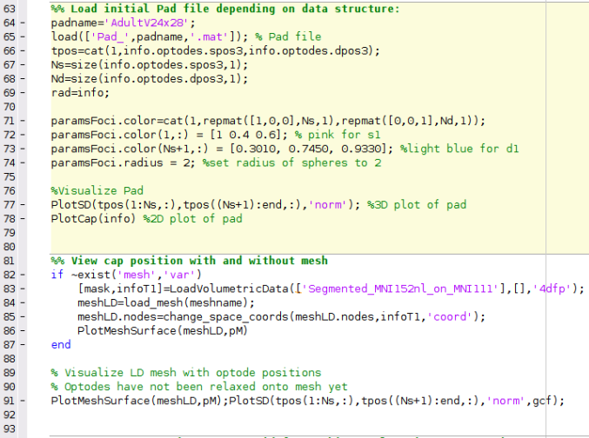
Running the script – Author’s Note
How the author runs the script
Highlight and execute each chunk of code
Ex: highlight lines 64-69 → right click → hit “Evaluate Selection”
Alternate way of running the script
For each section (beige) hit ctrl+enter
This isn’t how the author does it, but it will still work
Note: DO NOT HIT THE GREEN “RUN” BUTTON to run this script
MATLAB versions to use
Optimal version: MATLAB 2020b
The version that AlignMe was developed in
NIRFAST version to use
NIRFASTer, the newest release of NIRFAST
Found here: https://github.com/nirfaster/NIRFASTer
Example
section

Slide 9
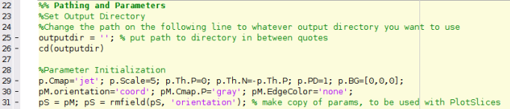
NeuroDOT Set-Up – In Script
The first section of code in this script will have you set your output directory and allow you to navigate to your desired output directory from within the script
Some parameters for visualizations made in the script are set up here as well

Slide 10
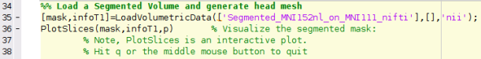
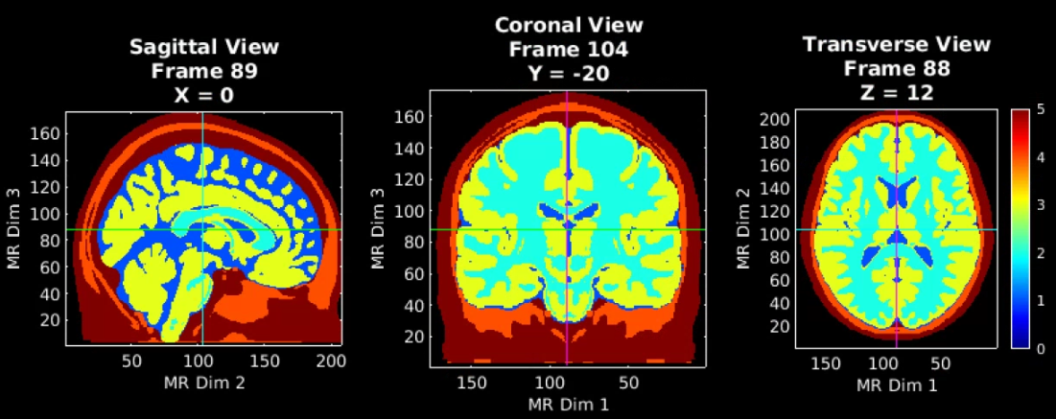
Load a Segmented volume and visualize
MRI Acquisition
Image Segmentation
Note that PlotSlices.m generates an interactive visualization of the volume. Simply press ‘q’ or the middle mouse button to release the figure.
5 – Scalp
4 – Skull
3 – Gray Matter
2 – White Matter
1 – CSF
0 - Background

Slide 11
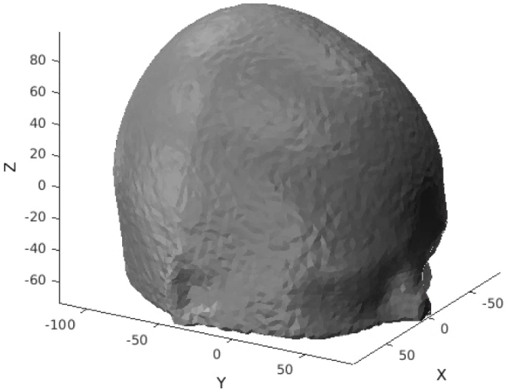
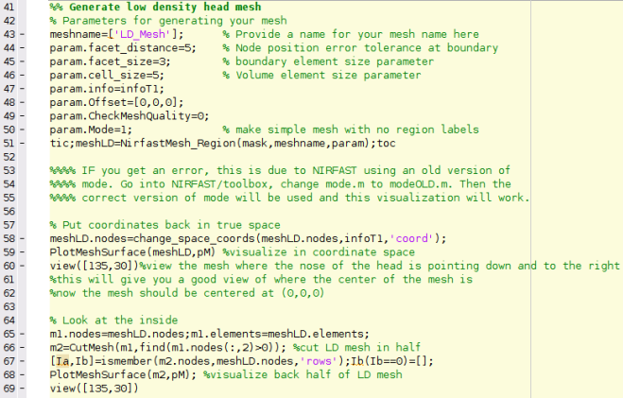
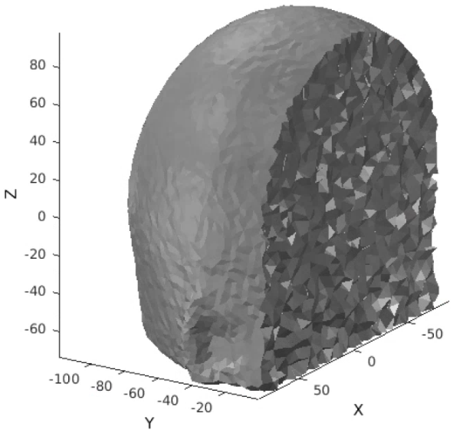
Generate a low-density mesh and visualize
MRI Acquisition
The low-density mesh will be used to efficiently align the optical array to its position on the head
Mesh generation parameters of note
facet_distance: error tolerance at boundary for node positions
facet_size: size of surface triangles
cell_size: size of internal tetrahedra
Mode: controls density of mesh, 1 for low density, 0 for high density
Image Segmentation
LD Mesh Generation
“coordinate space”
The origin is in the center of volume
A view inside

Slide 12
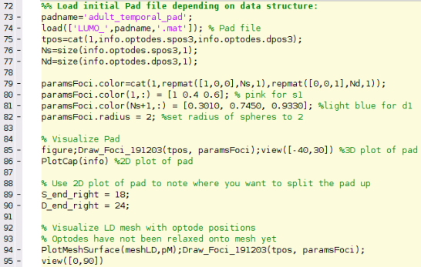
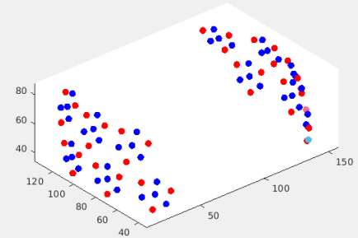
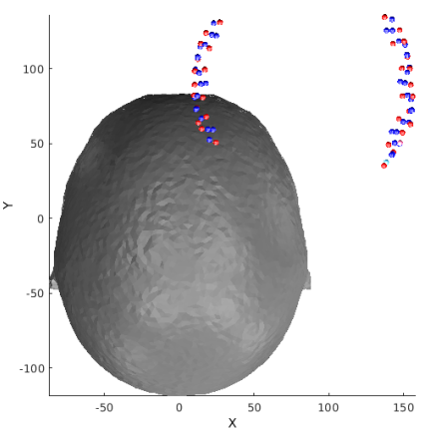
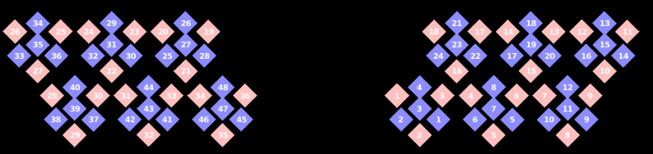
Load the Pad File
MRI Acquisition
Load in a Pad file for a grid design of interest, here we use the LUMO Adult Temporal Pad
Since this array has sections that cover the left and right sides of the head, we’ll need to split the pad up into those sections – the 2D layout is very helpful for this
Find the greatest source and detector numbers on the side of the pad that has S1 and D1. We’ll use these as indices to split the pad
Image Segmentation
LD Mesh Generation
Optode Placement

Slide 13
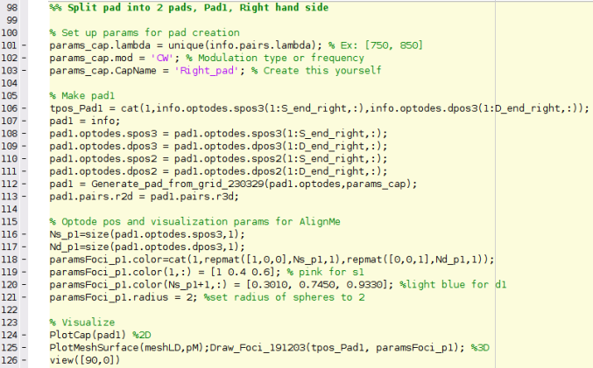
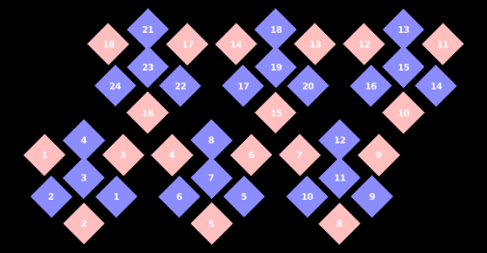
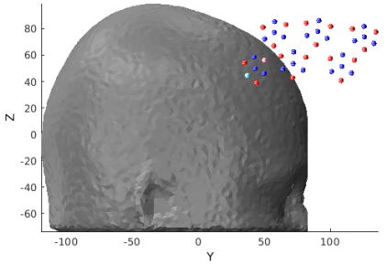
Make Right Side Pad
MRI Acquisition
We’ll now create a pad file for the right hand side optodes
Place the RHS optode positions in a structure
Run Generate_pad_from_grid
Visualize in 2D and 3D to make sure everything looks correct
Image Segmentation
LD Mesh Generation
Optode Placement

Slide 14
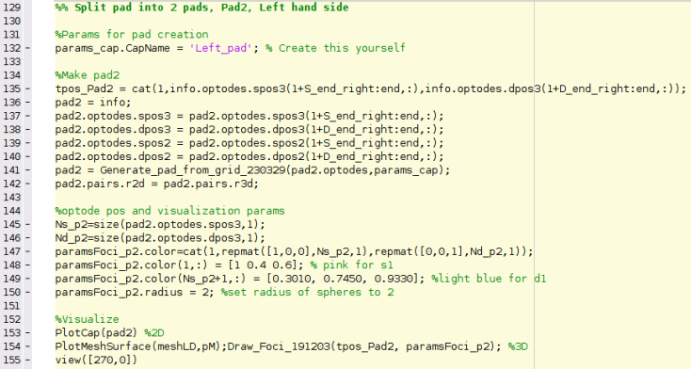
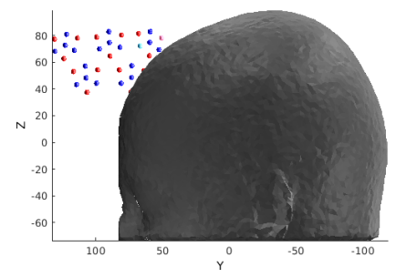
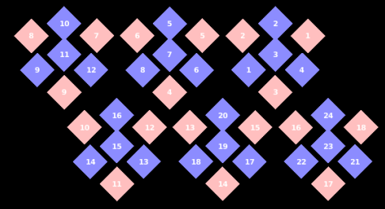
Make Left Side Pad
MRI Acquisition
Then we’ll do the same thing for the left hand side optodes
Image Segmentation
LD Mesh Generation
Optode Placement

Slide 15
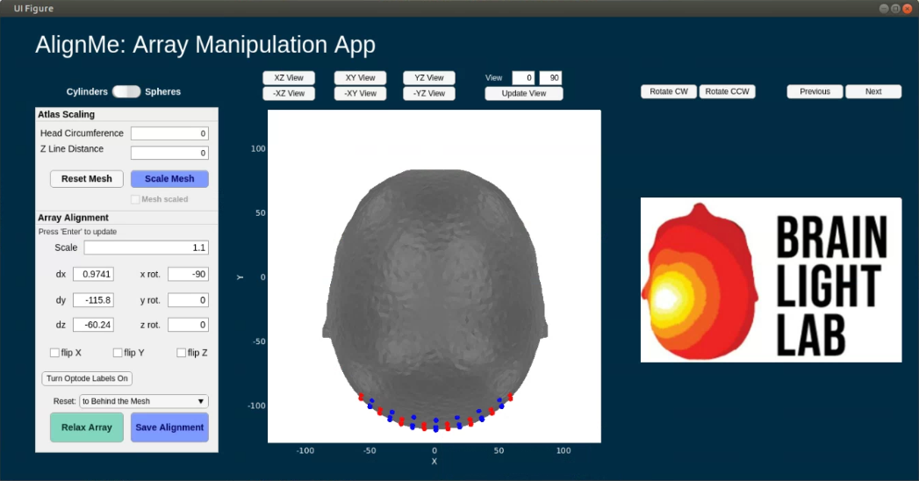
AlignMe Functionality
AlignMe allows for the user to scale the mesh to participant specific space by using
Participant Head Circumference
Participant Z line distance (nasion to inion)
These are contained within the Atlas Scaling box
Additionally, to facilitate easier alignment for participant specific situations, photos of the capfit can be utilized, and will show up where the Brain Light Lab logo is located on the GUI
Rotate CW, Rotate CCW: rotates photo
Previous, Next: scroll through available photos
Participant photos can be loaded in by setting the path to the directory containing photos. AlignMe will pull all files of the designated image type
Path to photos: ds.dI.photopath
Type of image: ds.dI.imageType
Change the fields in the Array Alignment box to position the array close to the head
Then press the “relax array” button to allow the array to relax onto the surface of the head. The GUI should then look like the figure above
Finally, use the “Save Alignment” button to save the relaxed optode positions to the workspace
NeuroDOT has an in depth walk through of how to use AlignMe in a standalone tutorial titled: NeuroDOT_Tutorial_AlignMe
The tutorial can be found in the Documentation/Scripts folder of the NeuroDOT toolbox

Slide 16
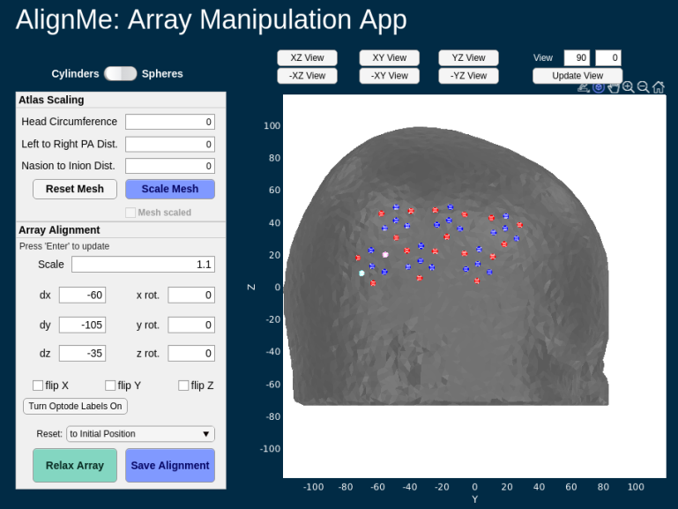
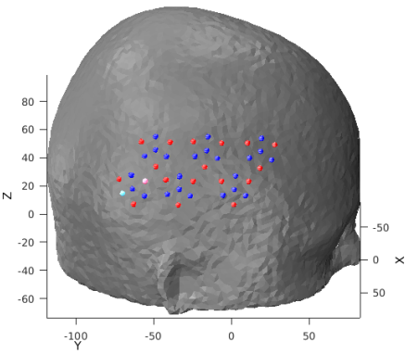
Relax Right Side Optodes
MRI Acquisition
Now we’ll use AlignMe to position the right hand side pad
Use the fields in the Array Alignment box outlined in red to position the array
Use the view buttons outlined in green to change the view of the brain
Image Segmentation
LD Mesh Generation
Optode Placement

Slide 17
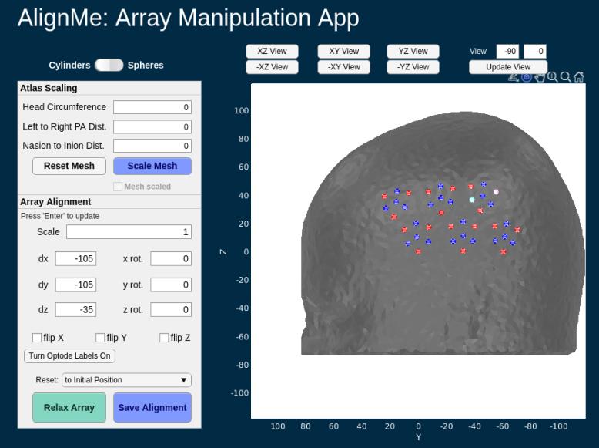
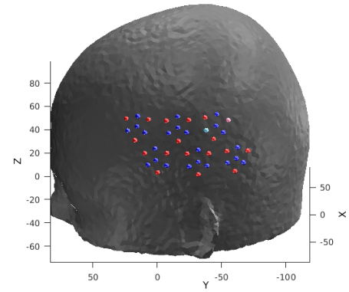
Relax Left Side Optodes
MRI Acquisition
Now we’ll use AlignMe to position the left hand side pad
Use dx to move the array to the left side of the mesh
You should keep the same values for dy and dz as the right hand side pad
Remember, these are two halves of the same pad
Image Segmentation
LD Mesh Generation
Optode Placement

Slide 18
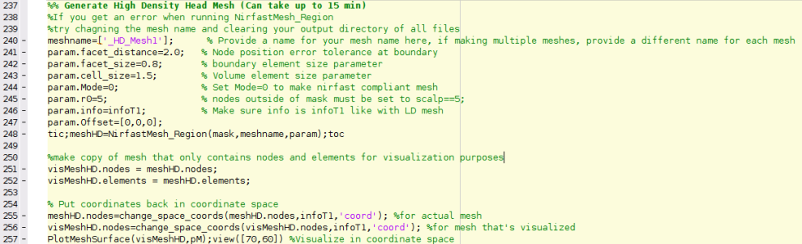
Generate a high-density mesh and visualize
MRI Acquisition
Now, we’ll create a high-density mesh. HD meshes contain a large number of nodes – close to 1,000,000 nodes but never more – in addition to some anatomical information
Notice the difference between the parameters used in LD mesh generation on slide 11 and those used here
Facet_distance is decreased
Facet_size is decreased, leading to more triangles that make up the surface of the mesh
Cell_size is decreased, there are more internal tetrahedra in HD meshes than LD meshes
Image Segmentation
LD Mesh Generation
Optode Placement
HD Mesh Generation
Notes:
NOTE: WE ARE NOT HAVING THEM RUN THESE SLIDES

Slide 19
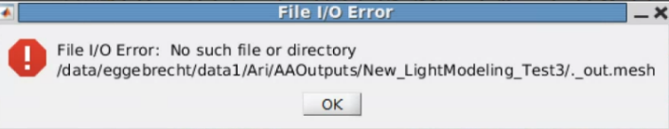
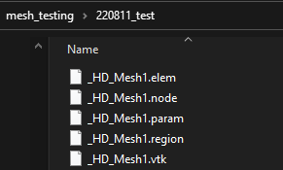
Possible errors during HD mesh generation
File I/O Error:
Solution: delete all mesh files in your output directory, change the meshname variable to a new name and re-run
Ex: ‘_HD_Mesh1’ → ‘_HD_Mesh0’
Make sure you delete these files from the file manager, and NOT within matlab
If the above doesn’t work, create an entirely new output directory, make that directory your current folder, then re-run lines 149-168
Poor mesh quality
Occurs if number of nodes in mesh is greater than 1,000,000
This is why we make smaller HD meshes and tune params.cell size
Pop-up box for File I/O Error
Files to delete if File I/O Error occurs

Slide 20
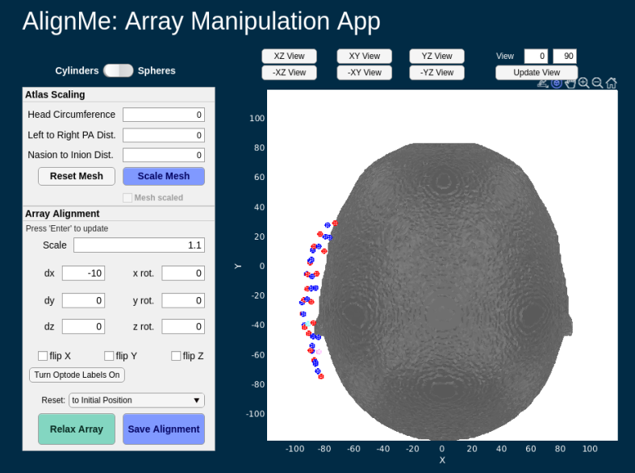
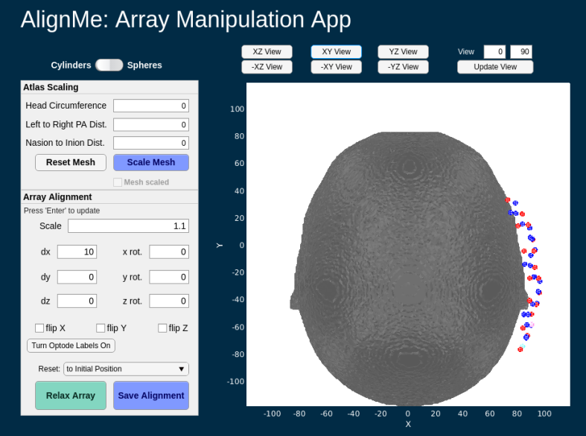
Place the optodes on the HD mesh
MRI Acquisition
This time, since the HD mesh is in the same space that the LD mesh was, the grid will already be lined up and sitting on the mesh when AlignMe starts. You’ll need to move it away from the mesh and re-relax the grid back onto the mesh
Change the view to “XY View”
Adjust the scale to 1.1 (this is the scale we used for the LD mesh too)
Move the grid off the mesh by setting dx = 10
The AlignMe GUI should now look like the image below
Hit “Relax Mesh” and then “Save Alignment” after the grid has been re-relaxed onto the mesh
Repeat steps 1-5 for the Left hand side pad, but set dx = -10
Image Segmentation
LD Mesh Generation
Optode Placement
HD Mesh Generation
Optode Placement
Note: using a HD mesh with AlignMe will make the app run more slowly

Slide 21
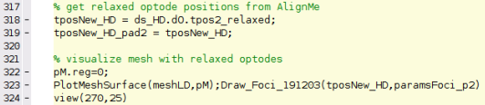
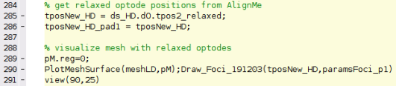
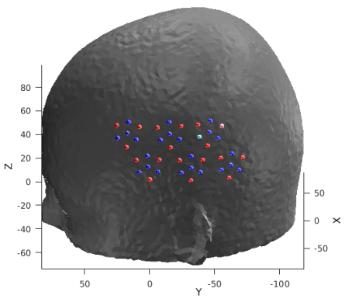
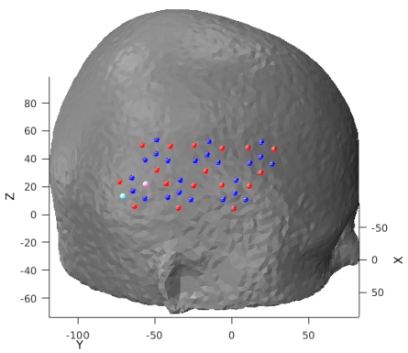
Get relaxed optode positions from AlignMe and visualize HD mesh + relaxed pad
MRI Acquisition
Image Segmentation
At the end of each AlignMe section, the relaxed optodes will be visualized on the HD mesh
LD Mesh Generation
Left
Right
Optode Placement
HD Mesh Generation

Slide 22
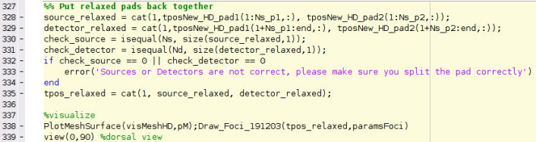
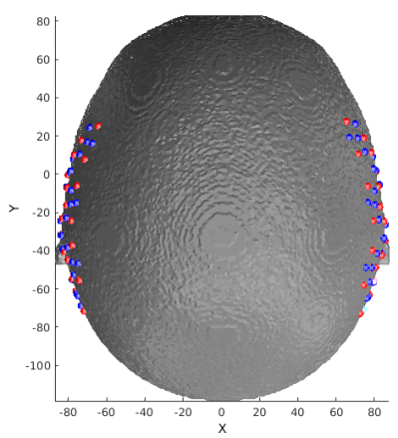
Put left and right pads back together
Now we’ll take the relaxed optode positions from both the left and right pads and put them together
After that, we’ll run two checks to check our work
Make sure the total number of sources and detectors match the numbers specified in the original pad file
Visualize all relaxed optodes on the mesh
MRI Acquisition
Image Segmentation
Mesh Generation
For both LD and HD meshes
Optode Placement

Slide 23
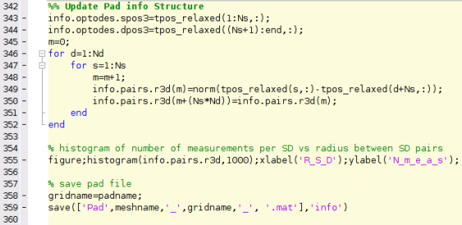
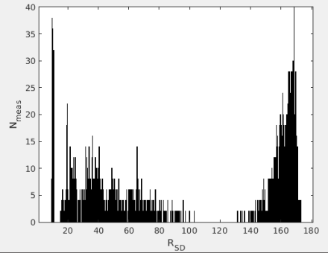
Update pad info structure after running AlignMe
After the pad has been relaxed onto the HD mesh, we need to update the info structure with the new optode locations
We’ll use those optode locations to re-calculate the 3D source-detector separations for every source-detector pair
After that we’ll make a histogram showing the relationship of measurements per separation distance
MRI Acquisition
Image Segmentation
Mesh Generation
For both LD and HD meshes
Optode Placement

Slide 24
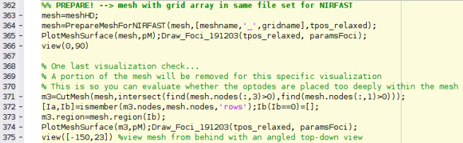
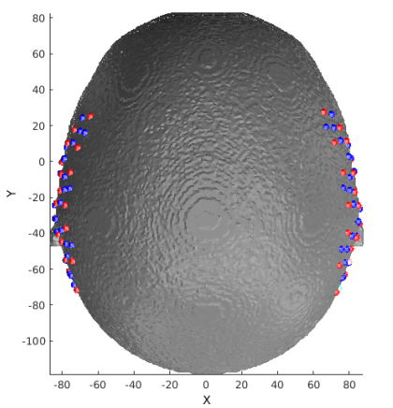
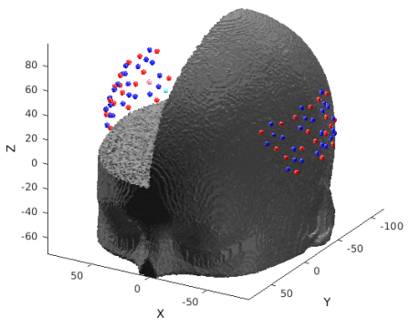
Calculate the sensitivity (1 of 3)
Prepare mesh and optode information for NIRFAST, then visualize
Visualize cap and mesh with portion cut out to make extra sure that optodes are not placed too far within the mesh
MRI Acquisition
Image Segmentation
Mesh Generation
For both LD and HD meshes
Optode Placement
Calculate Sensitivity
1.
2.

Slide 25
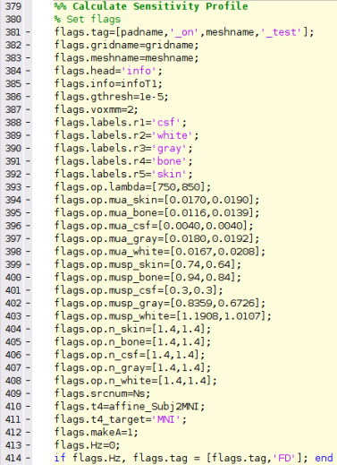
Calculate the sensitivity (2 of 3)
3. Set parameters for light modeling
MRI Acquisition
Voxelation resolution
Image Segmentation
Region labels
Mesh Generation
For both LD and HD meshes
Absorption Coefficients for regions
Optode Placement
Scattering Coefficients for regions
Calculate Sensitivity
Index of refraction for regions

Slide 26
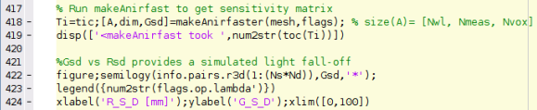
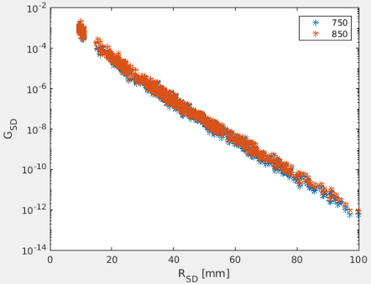
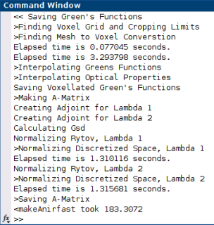
Calculate the sensitivity (3 of 3)
4. Calculate Green’s functions, voxelate, create sensitivity matrix, adjust bookkeeping
MRI Acquisition
Image Segmentation
Mesh Generation
For both LD and HD meshes
If makeAnirfaster is successful, output like the below screenshot should show up in your command window
Optode Placement
Calculate Sensitivity

Slide 27
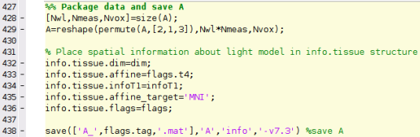
Package Sensitivity Matrix with associated info
5. Reshape A so it’s the following size: Nwl*Nmeas X Nvox
6. Place spatial information about light model in info.tissue structure
MRI Acquisition
Image Segmentation
Mesh Generation
For both LD and HD meshes
Optode Placement
Calculate Sensitivity

Slide 28
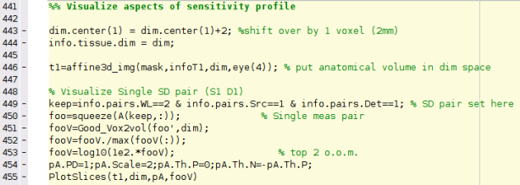
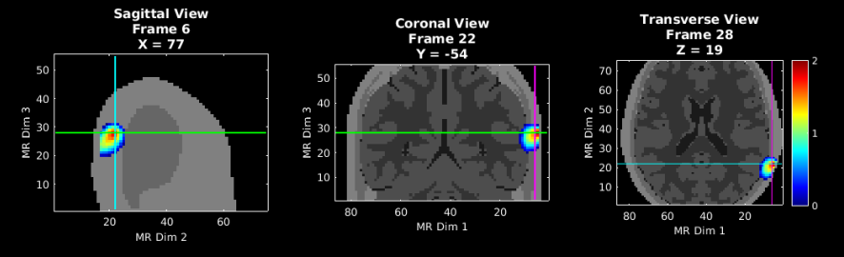
Validate the sensitivity (1 of 3)
Let’s visualize the sensitivity of the A matrix. We’ll start with a single source detector pair (Source 1, Detector 1) and then visualize the full sensitivity profile (FFR) on slide 28
MRI Acquisition
Image Segmentation
Mesh Generation
For both LD and HD meshes
Optode Placement
Calculate Sensitivity
Single SD pair: source 1 detector 1
Validate Sensitivity

Slide 29
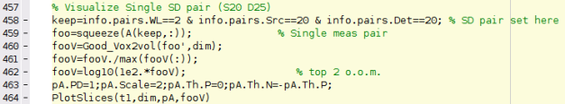
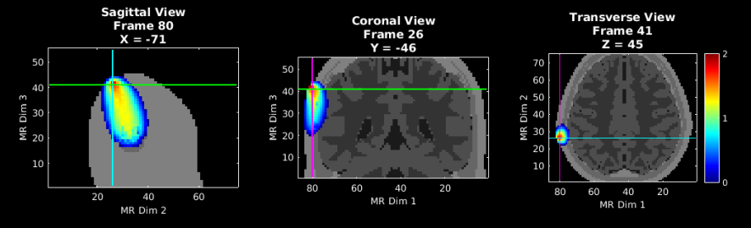
Validate the sensitivity (2 of 3)
Click on the areas that light up on each slice to better see the sensitivity profile for measurements recorded from Source 20 and Detector 25
MRI Acquisition
Image Segmentation
Mesh Generation
For both LD and HD meshes
Optode Placement
Single SD pair: source 20 detector 25
Calculate Sensitivity
Validate Sensitivity

Slide 30
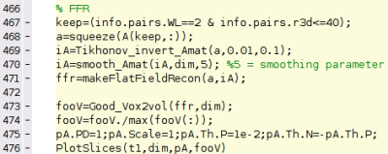
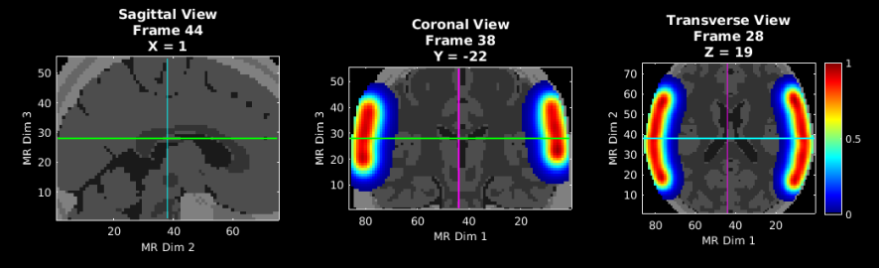
Validate the sensitivity (3 of 3)
Visualize the flat field reconstruction
MRI Acquisition
Image Segmentation
Mesh Generation
For both LD and HD meshes
Optode Placement
Calculate Sensitivity
Validate Sensitivity

Slide 31
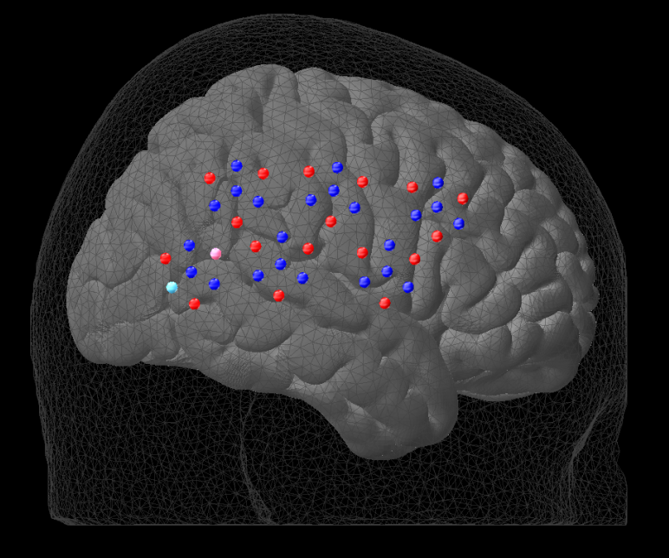


Put it all together
As a final check, let’s visualize the alignment of the LD mesh, optode array, and cortical meshes all together
We are not visualizing the HD mesh because for this array, the HD mesh is the same size as the LD mesh

Slide 32
Help Expand NeuroDOT’s Utility!
Please fill out the NeuroDOT registration form to help us better develop the NeuroDOT toolbox and expand its utility to address your fNIRS/DOT data analysis needs:
https://forms.gle/8QNGnx7ZbKuUHg3bA
Additionally, please provide specific feedback, or ask questions to the development team:
https://forms.gle/jv6RkX5s784LgQC89
Note: you will not be contacted by the NeuroDOT development team unless you opt-in to receiving communications.

Slide 33
That’s It (For Now)
Congratulations! You have finished the NeuroDOT Split Pad Light Modeling Pipeline Tutorial for the LUMO Adult Temporal pad using AlignMe.
See other Sample Results Appendices for example visualizations of these same processing steps on the other Sample Data included in the toolbox.
Also, see the PreProcessing and Reconstruction tutorials to gain a deeper understanding of the effects of altering the processing parameters.
NeuroDOT Support: neurodot-support@wustl.edu

